Slide 1

HAMZA GHARIANI 4 NIDS 1

Slide 2
VMware ESXi

Slide 3
PLAN
01
02
03
04
INTRODUCTION
Introduction to iVMware ESXi
FEATURES AND BENEFITS
The key features and benefits of ESXi
ARCHITECTURE
High-level overview of the architecture of ESXi
INSTALLATION
Steps involved in installing and configuring ESXi

Slide 4
PLAN
05
06
07
08
VM MANAGEMENT
Overview of how to manage virtual machines in ESXi
PERFORMANCE
Best practices for optimizing the performance
SECURITY
The importance of securing virtual machines and ESXi hosts
LICENSING AND SUPPORT
Information on the licensing and support options available for ESXi

Slide 5
01
Introduction to VMWARE ESXI

Slide 6
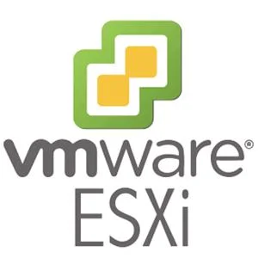
INTRODUCTION
1.1
Virtualization is the process of running multiple virtual machines on a single physical host, providing improved hardware utilization, simplified management, and increased flexibility. One of the leading virtualization platforms is VMware ESXi, a fast, efficient, and scalable type-1 hypervisor that supports multiple operating systems and provides a wide range of management and automation tools. ESXi is an ideal choice for businesses looking to reduce hardware costs, simplify management, and increase flexibility.

Slide 7
02
FEATURES AND BENEFITS

Slide 8
FEATURES AND BENEFITS
VMware ESXi provides a wide range of features and benefits that make it an ideal choice for businesses looking to improve their IT infrastructure. One of its key features is high availability, which ensures that virtual machines remain available and operational even in the event of hardware failures. ESXi also provides advanced resource management capabilities, allowing businesses to allocate and manage hardware resources such as CPU, memory, and storage to ensure optimal performance. Additionally, ESXi supports multiple operating systems, making it a flexible solution for businesses with a variety of application and workload needs. Overall, these features and benefits make ESXi a powerful and versatile virtualization platform for businesses of all sizes.

Slide 9
03
ARCHITECTURE

Slide 10
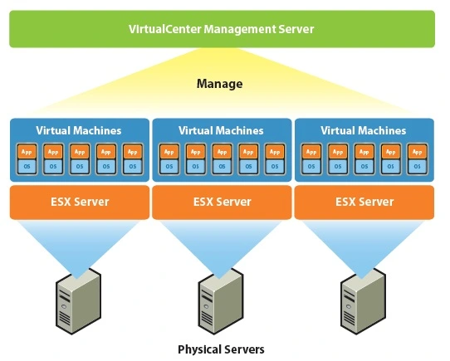
VMWARE ESXi ARCHITECTURE
VMware ESXi consists of a small hypervisor that runs directly on the physical server hardware, a management console for managing the virtual environment, and a virtual machine file format for storing virtual machine data. This modular architecture provides businesses with a scalable and flexible platform for virtualization.

Slide 11
04
INSTALLATION

Slide 12
05
VIRTUAL MACHINE MANAGEMENT

Slide 13
06
PERFORMANCE

Slide 14
BEST PRACTICES TO OPTIMIZE THE PERFORMANCE
Resource allocation
Monitoring and troubleshooting
Capacity planning
Carefully manage hardware resources such as CPU, memory, and storage to ensure virtual machines have the resources they need to run optimally.
Regularly monitor virtual machine performance and address issues that may impact performance, such as disk latency or network congestion.
Forecast future resource needs and ensure there is enough capacity to meet those needs.

Slide 15
07
SECURITY

Slide 16
SECURITY
Securing virtual machines and ESXi hosts is essential for maintaining the integrity and confidentiality of sensitive data and applications. VMware ESXi offers a range of security features to protect virtual environments from threats, such as secure boot, which ensures that only trusted software is loaded during boot time, and virtual machine encryption, which provides encryption of virtual disks and their contents. Other security features include virtual machine firewalls, user authentication and access controls, and security information and event management (SIEM) integration. By leveraging these security features, businesses can enhance the security of their virtual environment and protect against potential security breaches.

Slide 17
08
LICENSING AND SUPPORT

Slide 18
LICENSING AND SUPPORT
01
02
03
VMware ESXi is available in free and paid versions, with paid versions offering more advanced features and capabilities.
FREE
Basic features for businesses to explore virtualization without any upfront costs.
PAID
Advanced features and flexible support options to meet business needs.
SUPPORT
VMware ESXi paid versions offer advanced features and flexible support options to meet business needs.
You can describe the topic of the section here

Slide 19
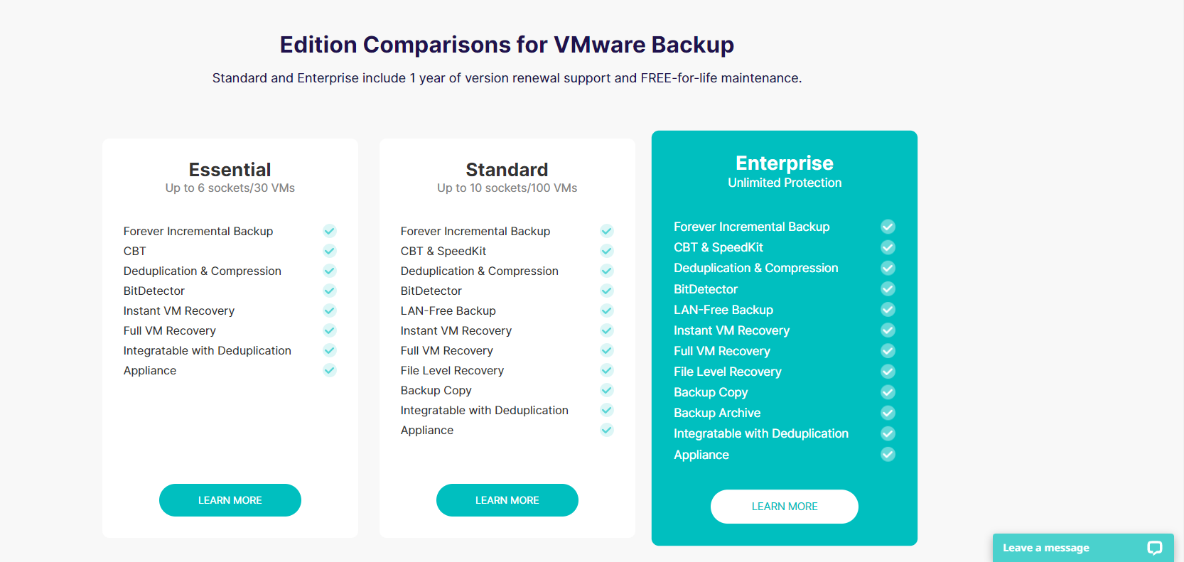
EDITION COMPARISONS
You can describe the topic of the section here

Slide 20
09
CONCLUSION

Slide 21
VMware ESXi offers advanced features and flexible support options, making it a highly recommended virtualization platform for businesses to increase efficiency, reduce costs, and streamline IT operations.

